Slide 1
web app
object:create web app using react,react router,bootstrap and google font.
description: in the web application I have used multiple pages components like login,resister,add sales,revenue,top prosuct,logout and Navbar components. I am showing all the components with its screenshot.

Slide 2
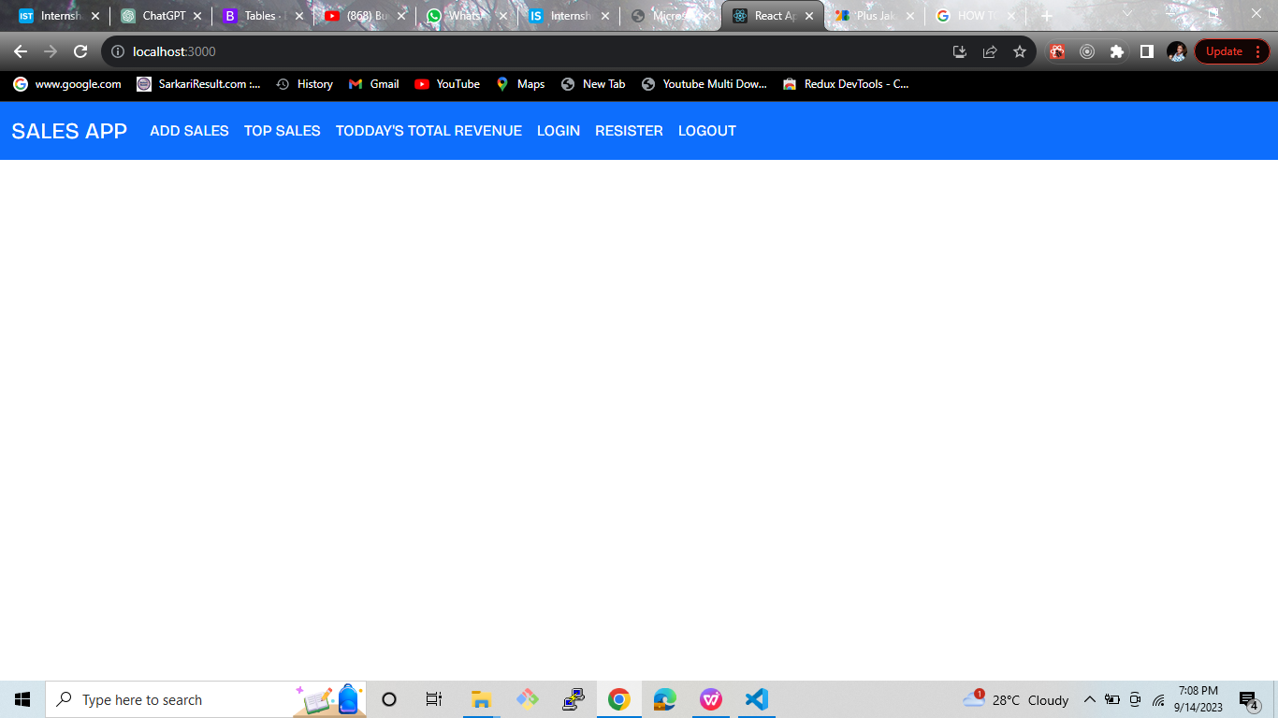
Navbar(Desktop Screen):

Slide 3
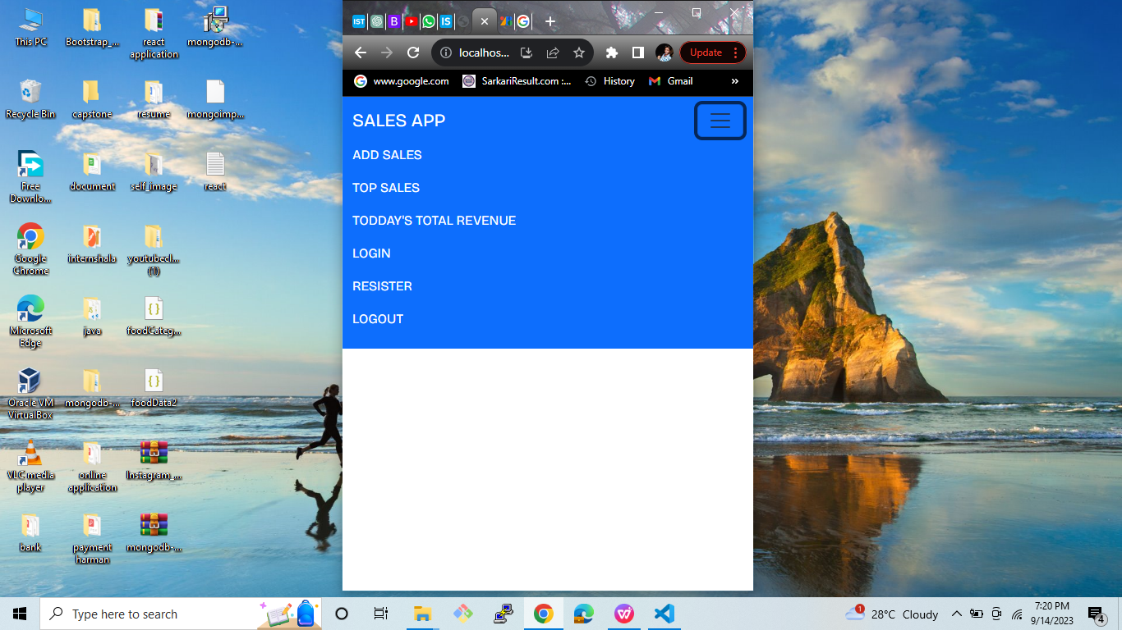
Navbar(Mobile Screen):

Slide 4
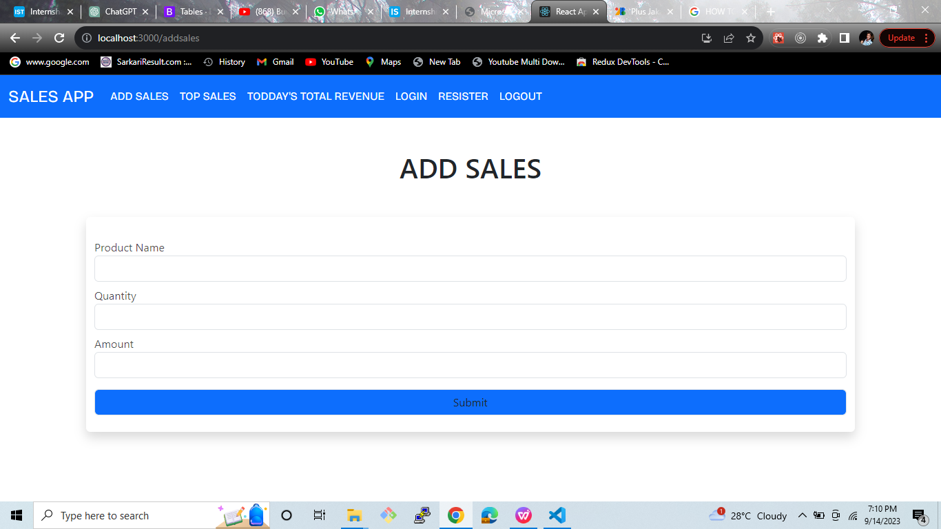
Add Sales (desktop):

Slide 5
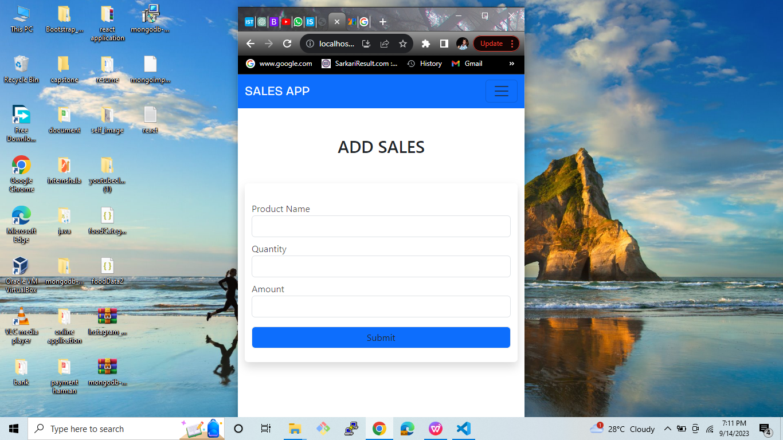
add sales (mobile screen):

Slide 6
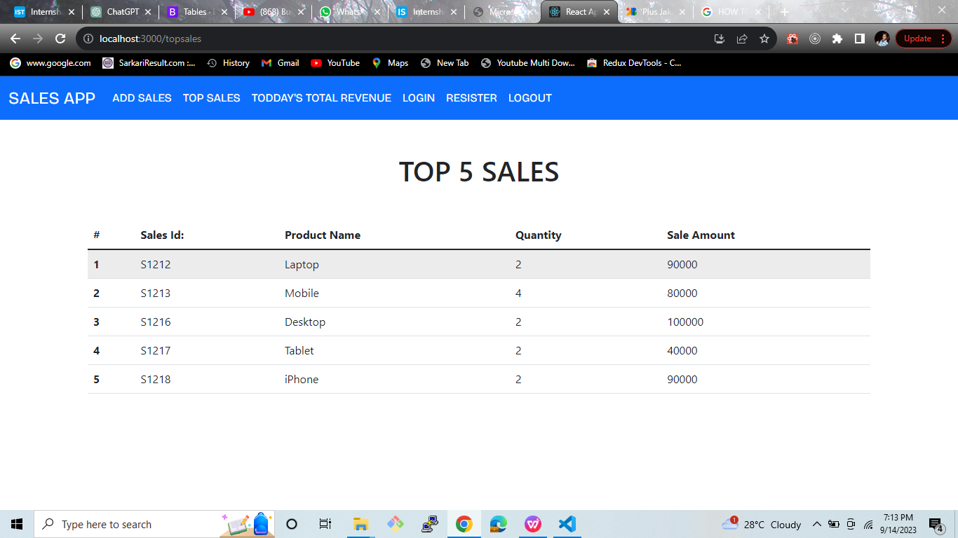
Top 5 Sales(desktop screen):

Slide 7
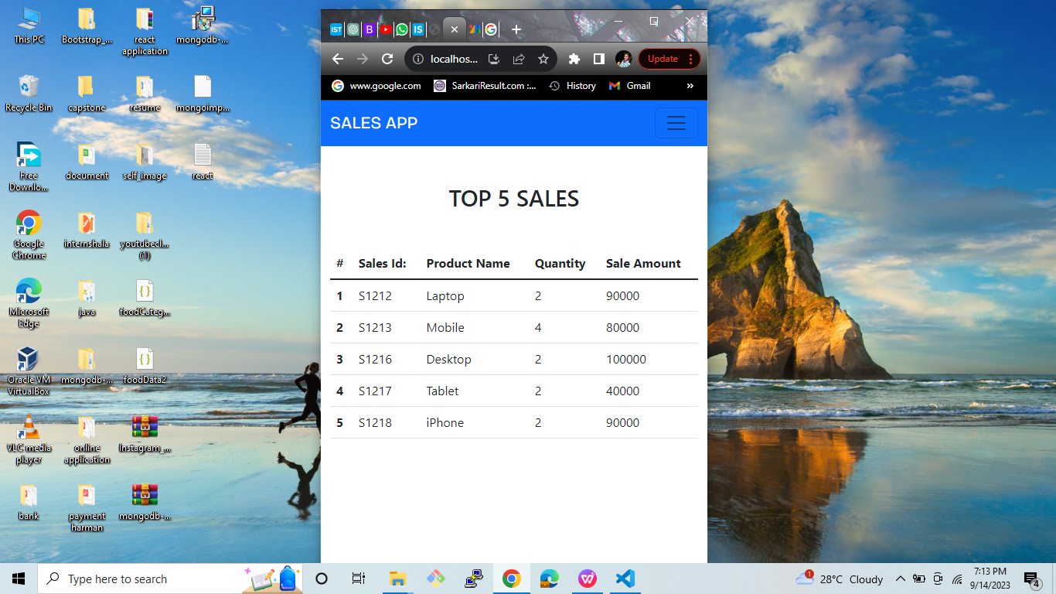
Top 5 sales(mobile screen):

Slide 8
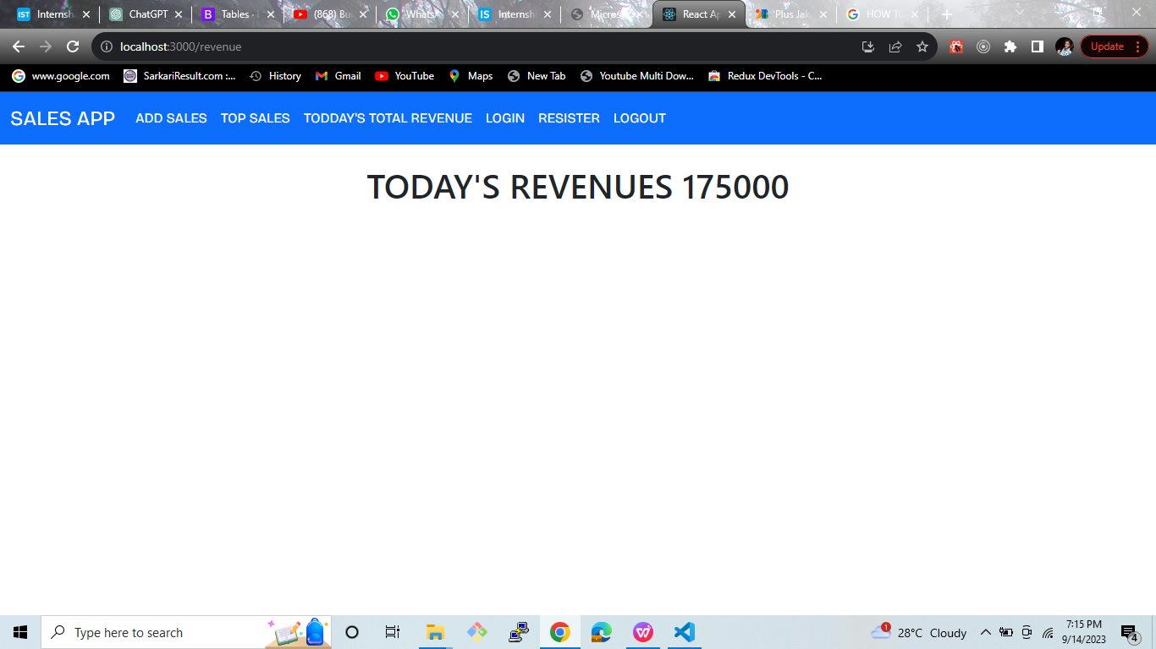
Today’s Revenue:

Slide 9
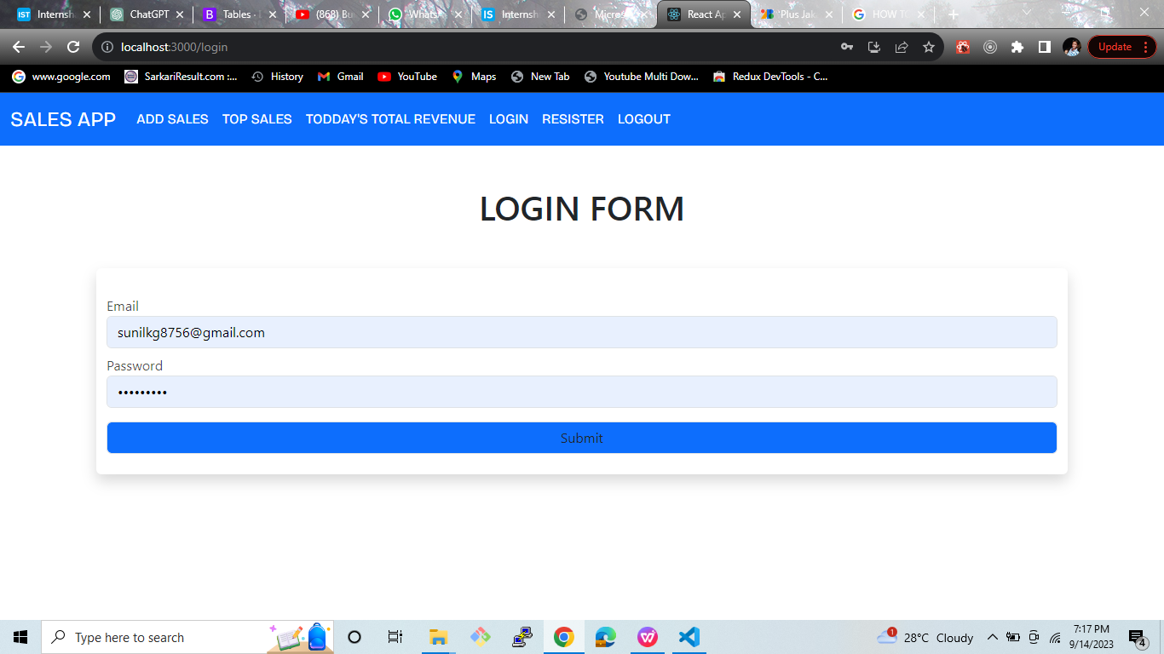
Login(Desktop Screen):

Slide 10
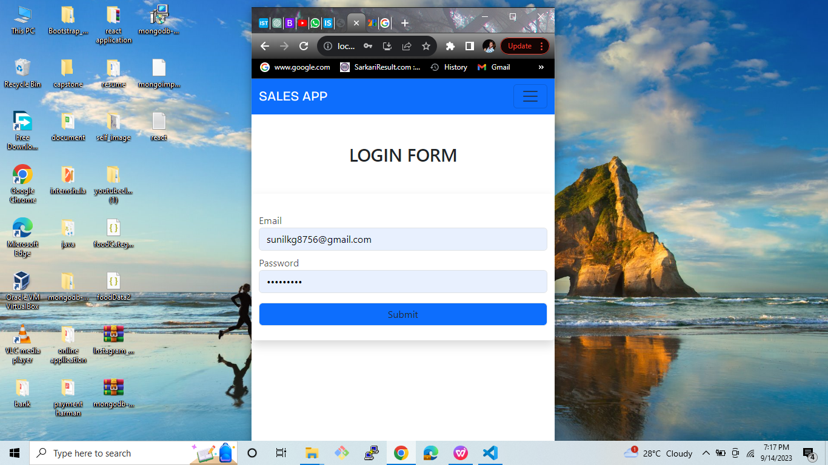
Login(Mobile Screen):

Slide 11
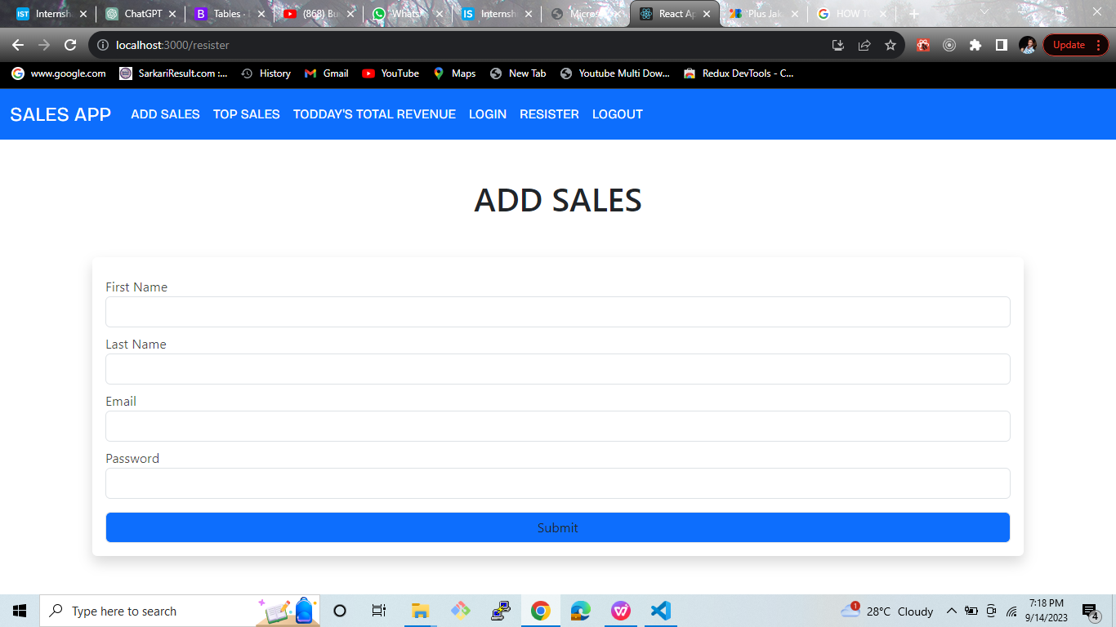
Resister(Desktop Screen):

Slide 12
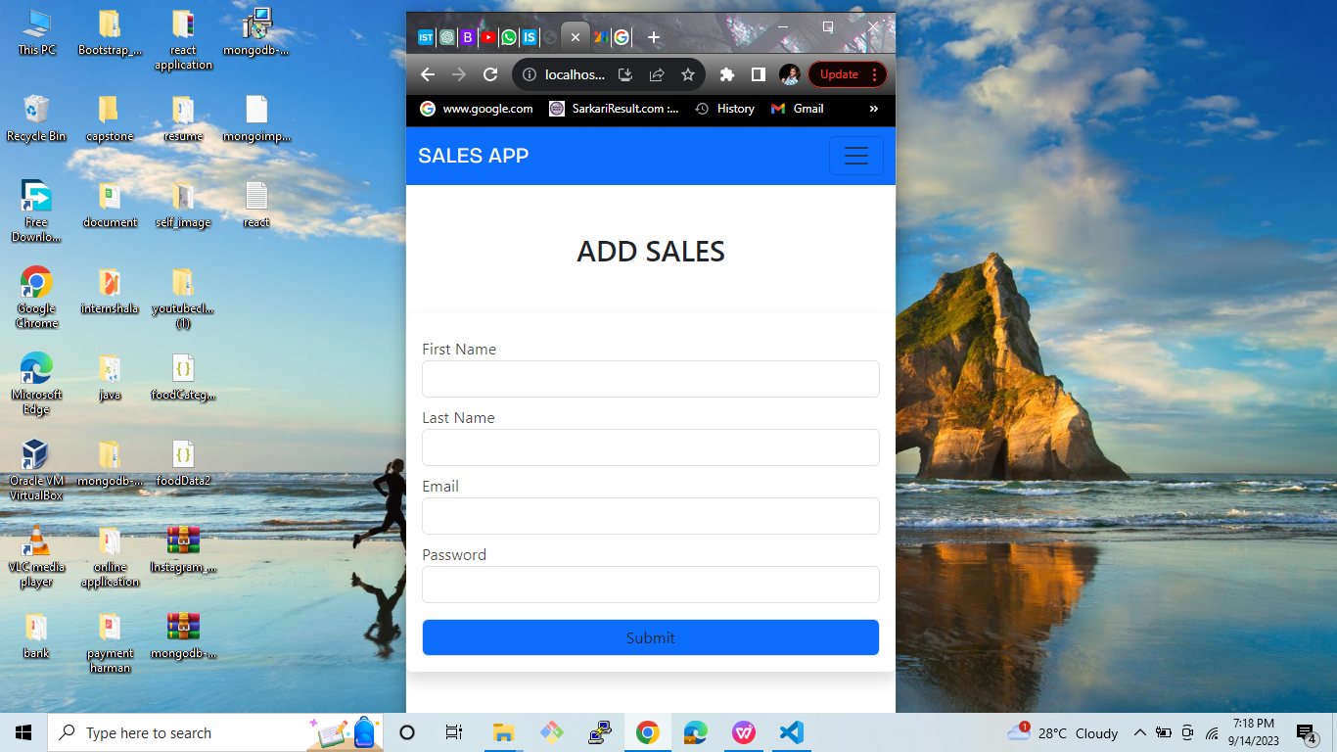
Resister (Mobile Screen):

Slide 13
Backend:
for creating backend i have used mongoose and express and node.
I have created 4 api.
1:signup user api:
in this api they take the data from the body and after taking data they check body is given requirement data are not if not given they return response ‘please enter all details’ if given they stored all the data in the mongodb database. and also be change password using BCRYPT and then store.

Slide 14
2:Create Login API:
in the login api user post the data like email and password to the server.the server check the data is correct or not if correct they retur n token ‘token is created through the jsonwebtoken module and taking unique id for creating token’and user data.

Slide 15
3.creating post api :
creating post api for storing data of the user.
before sending request to the server I have used middleware for checking this user authorized or not if not authorized then send response ‘please signup or login’ if authorized then they store the data in mongodb database.
in the middleware they take token of the user and check user login or not.

Slide 16
4.creating api for showing all data
I have create get api for fetching all data through the database.
I have sent the req from the body .
they can fetch all data and send the response as all data.
also be use for caluculating total revenue.

Slide 17
models:
I have create two models
1 :user:
here I have create user Schema.
using this schema for storing all user details.
I have created 4 key like name,lastname,email,password.

Slide 18
2:Post model:
main purpose of creating this Schema for storing user data.
in this schema i have used 4 key like quantity,amount and productname.
I have also use author key for storing use model detail bywhich we find this data of which user.

